Slide 1
Traffic Lights Attention
But we start with the basics here

Slide 2
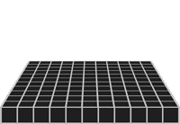
Gray Scale Image
A digital camera uses an array of millions of tiny light cavities or "photosites" to record an image. When you press your camera's shutter button and the exposure begins, each of these is uncovered to collect photons and store those as an electrical signal. Once the exposure finishes, the camera closes each of these photosites, and then tries to assess how many photons fell into each cavity by measuring the strength of the electrical signal. The signals are then quantified as digital values, with a precision that is determined by the bit depth.
A pixel in each “box”
Notes:
חיישן צבע אחד

Slide 3
Image Color
The cavities illustration would only create grayscale images, since these cavities are unable to distinguish how much they have of each color. To capture color images, a filter has to be placed over each cavity that permits only particular colors of light. Virtually all current digital cameras can only capture one of three primary colors in each cavity, and so they discard roughly 2/3 of the incoming light. As a result, the camera has to approximate the other two primary colors in order to have full color at every pixel.
3 pixels in each “box”
A color per layer
Notes:
חיישן תיאורטי ל-3 צבעים. מזכיר CCD3 של סוני משנות ה-80

Slide 4
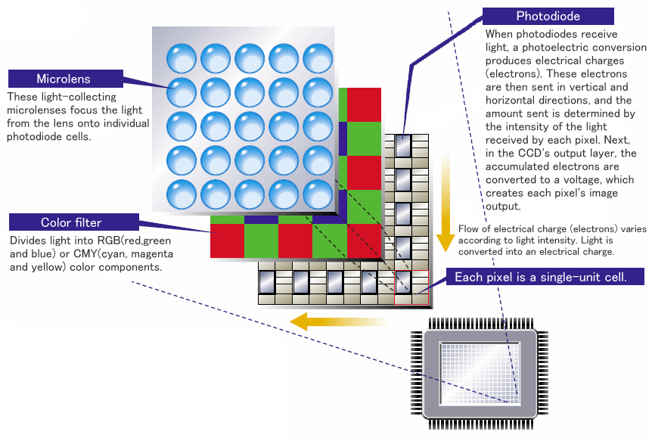
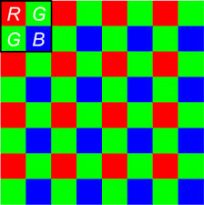
Bayer Filter
Bayer color filter array is a popular format for digital acquisition of color images. The pattern of the color filters is shown below (left). Note that half of the total number of pixels are green
Right image shows how a Bayer patter RGB sensor is implemented. Note the layers of micro-lenses above the sensor, which perform low-pass filtering
Notes:
שימו לב שהירוק דומיננטי

Slide 5
BAYER DEMOSAICING
A demosaicing (also de-mosaicing, demosaicking or debayering) algorithm is a digital image process used to reconstruct a full color image from the incomplete color samples output from an image sensor overlaid with a color filter array (CFA). It is also known as CFA interpolation or color reconstruction.
Most modern digital cameras acquire images using a single image sensor overlaid with a CFA, so demosaicing is part of the processing pipeline required to render these images into a viewable format.
The aim of a demosaicing algorithm is to reconstruct a full color image (i.e. a full set of color triples) from the spatially undersampled color channel output from the CFA.
Notes:
להסביר בקצרה

Slide 6
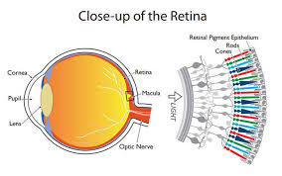
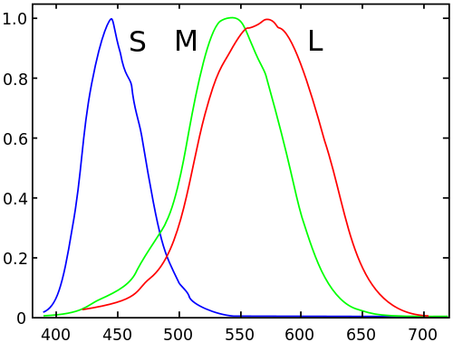
RGB
The RGB color model is an additive color model in which red, green and blue light are added together in various ways to reproduce a broad array of colors. The name of the model comes from the initials of the three additive primary colors, red, green, and blue.
RGB is used in capturing and displaying images, because it is related to the physics of the human eye’s sensing.
Since the human eye is not “perfectly engineered”, it is often useful to convert to different color spaces for compression and for image processing. (HSV, YCbCr, …)
The human eye/brain normalizes the precepted color relative to the surrounding, so in many cases same RGB values are precepted differently when indoor/outdoors. This is usually compensated with a mechanism called “white balance”
Notes:
אז מה זה RGB. למה RGB
מילה על White balance

Slide 7
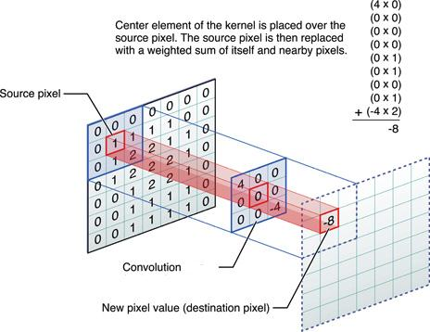
Filtering an Image
Image filtering is useful for many applications, including smoothing, sharpening, removing noise, and edge detection.
Notes:
מה שרואים פה זה...

Slide 8
Filtering an Image
A filter is defined by a kernel, which is a small array applied to each pixel and its neighbors within an image.
We “put” the kernel above the image, then multiply every matching pixels, and sum the result into the “destination pixel”
Notes:
קרנל זז מעל לתמונה

Slide 9
Filtering an Image
It’s usually convenient to have a square odd kernel size, 3x3, 5x5 and so, because this way we have a “center” to the kernel
Notes:
לעבור על החשבון. לאן נכתבת התוצאה

Slide 10
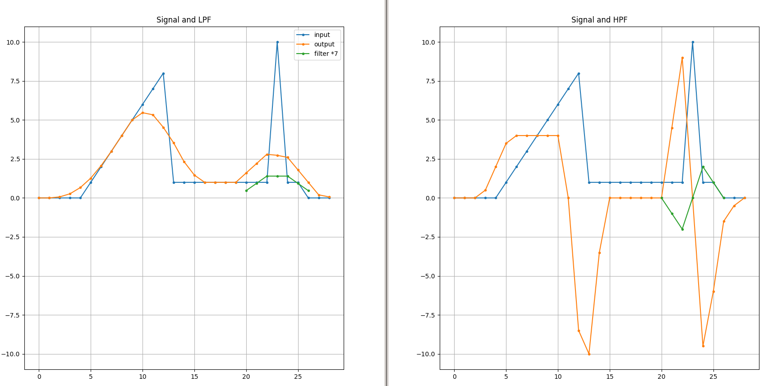

Low Pass Filter
A low-pass filter (LPF) smoothens the image by averaging small details.
Usually applied using a symmetric “hill-shape” kernel to perform a moving average over the neighboring pixels
This mostly averages “fast changing” details which contain high frequencies in the image
Here is a 3x3 example:
Notes:
דוגמא בחד מימד בציור
קרנל למטה לדו מימד

Slide 11
Low Pass Filter
A low-pass filter (LPF) smoothens the image by averaging small details.
Usually applied using a symmetric “hill-shape” kernel to perform a moving average over the neighboring pixels
This mostly averages “fast changing” details which contain high frequencies in the image
Here is a 3x3 example:
This is the filter (in green)

Slide 12
Low Pass Filter
Output == input because input is linear / slowly changing
A low-pass filter (LPF) smoothens the image by averaging small details.
Usually applied using a symmetric “hill-shape” kernel to perform a moving average over the neighboring pixels
This mostly averages “fast changing” details which contain high frequencies in the image
Here is a 3x3 example:
Fast changes are smoothed

Slide 13
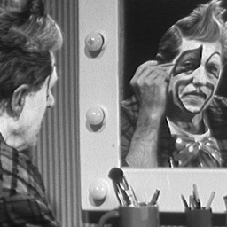
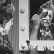
Low Pass Filter Image Example

Slide 14

High Pass Filter
The high pass filter extracts the small gradients, while reducing the “mean” of slow changing modes.
Note that in many cases, the HPF will result a signed image, i.e. will insert negative values.
When displaying the image, you will usually see the value of 0 as 50% gray, and the small details going to white/black
Note the differences between the 2D example and the 1D example
*Note: Convolution includes flipping the kernel around each axis
Notes:
רק שקף אחד. להסביר הכל:
מה שונה בין D1 ל-D2 ?
מציאת נגזרת של הסיגנל (D1). ב-D2 למעשה LPF-1

Slide 15
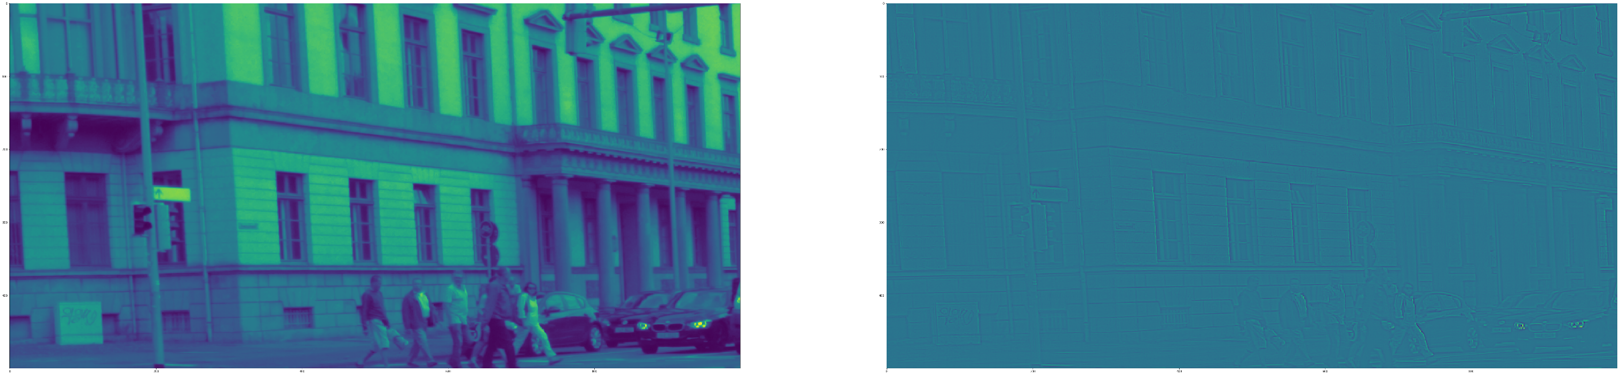
High Pass Filter Example
Notes:
מי רואה משהו? למה לא רואים כלום? לחזור שקף אחורה

Slide 16
High Pass Filter Example
← Zoom in

Slide 17
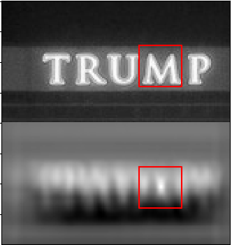
Generally detecting a pattern
Chose this as a kernel
The convolution performs a dot product of the image with the kernel on every pixel.
The more similar the image part is (to the kernel), the higher the result will be
This means that if the kernel “looks like” certain features in the image we search for, we’ll get an attention around these areas
Same rect on result image
Notes:
קרנל הכי אוהב את עצמו. כמו מכפלה פנימית (נירמול ממוצע)

Slide 18
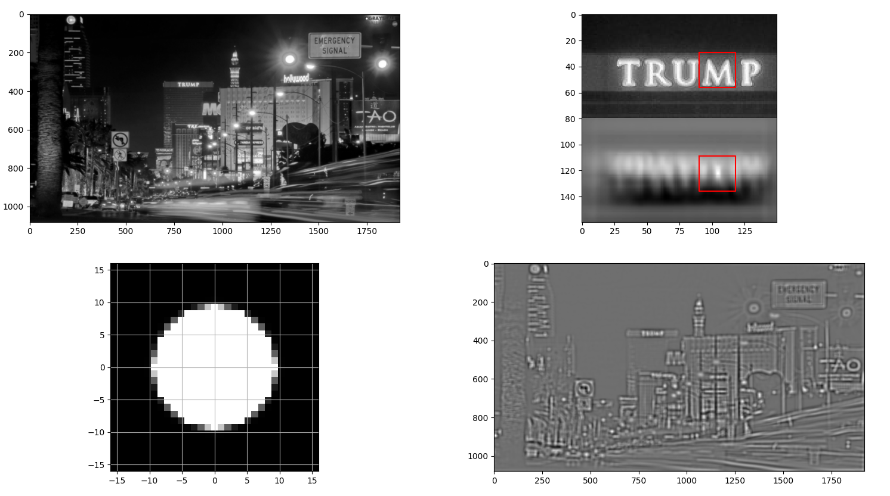
Generally detecting a pattern
But this one too big
Kernel “likes” bright spots on dark background
Same rect on result image
Notes:
לא קל למצוא קרנל. להסביר למה הביצועים לא כ"כ טובים פה

Slide 19
Non-max suppression
We got a score-per-pixel of an attention, now we want to find the best K spots
Problem: convolution result is smooth, so the 2nd best pixel is probably a neighbor of the best one
2nd highest value
Max value
Notes:
אבל אחרי שמרוצים מהקרנל, עדיין לא נגמר

Slide 20
Non-max suppression
We got a score-per-pixel of an attention, now we want to find the best K spots
Problem: convolution result is smooth, so the 2nd best pixel is probably a neighbor of the best one
Solution: suppress (=make quiet) the neighbors of the max
Local max or not??
Max value in local window
Max value in local window

Slide 21
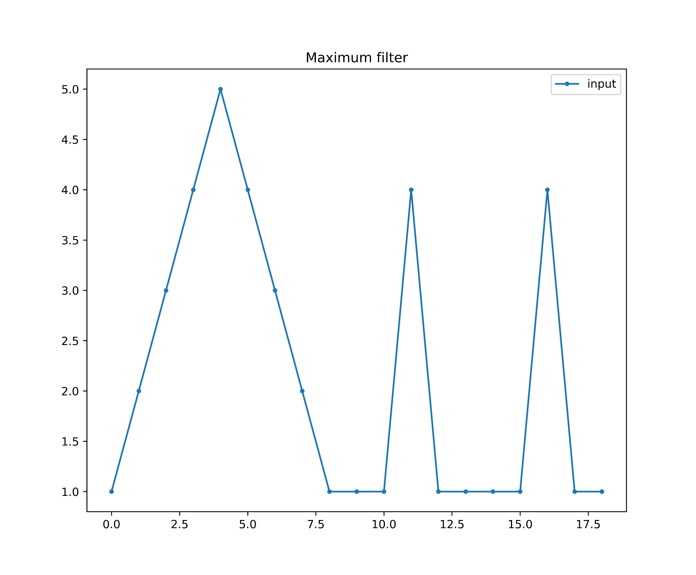
Non-max suppression
scipy.ndimage.maximum_filter

Slide 22
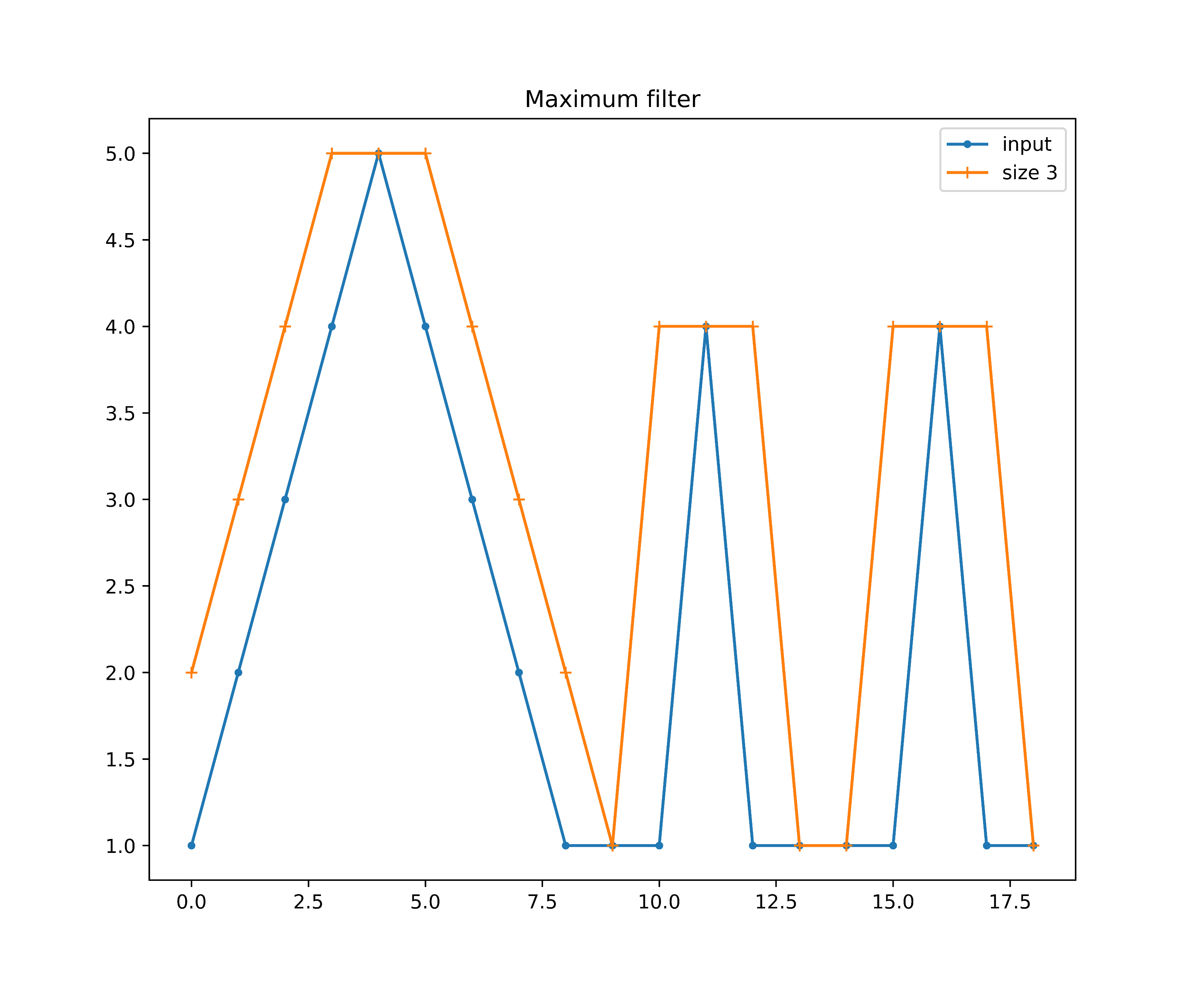
Non-max suppression
scipy.ndimage.maximum_filter

Slide 23
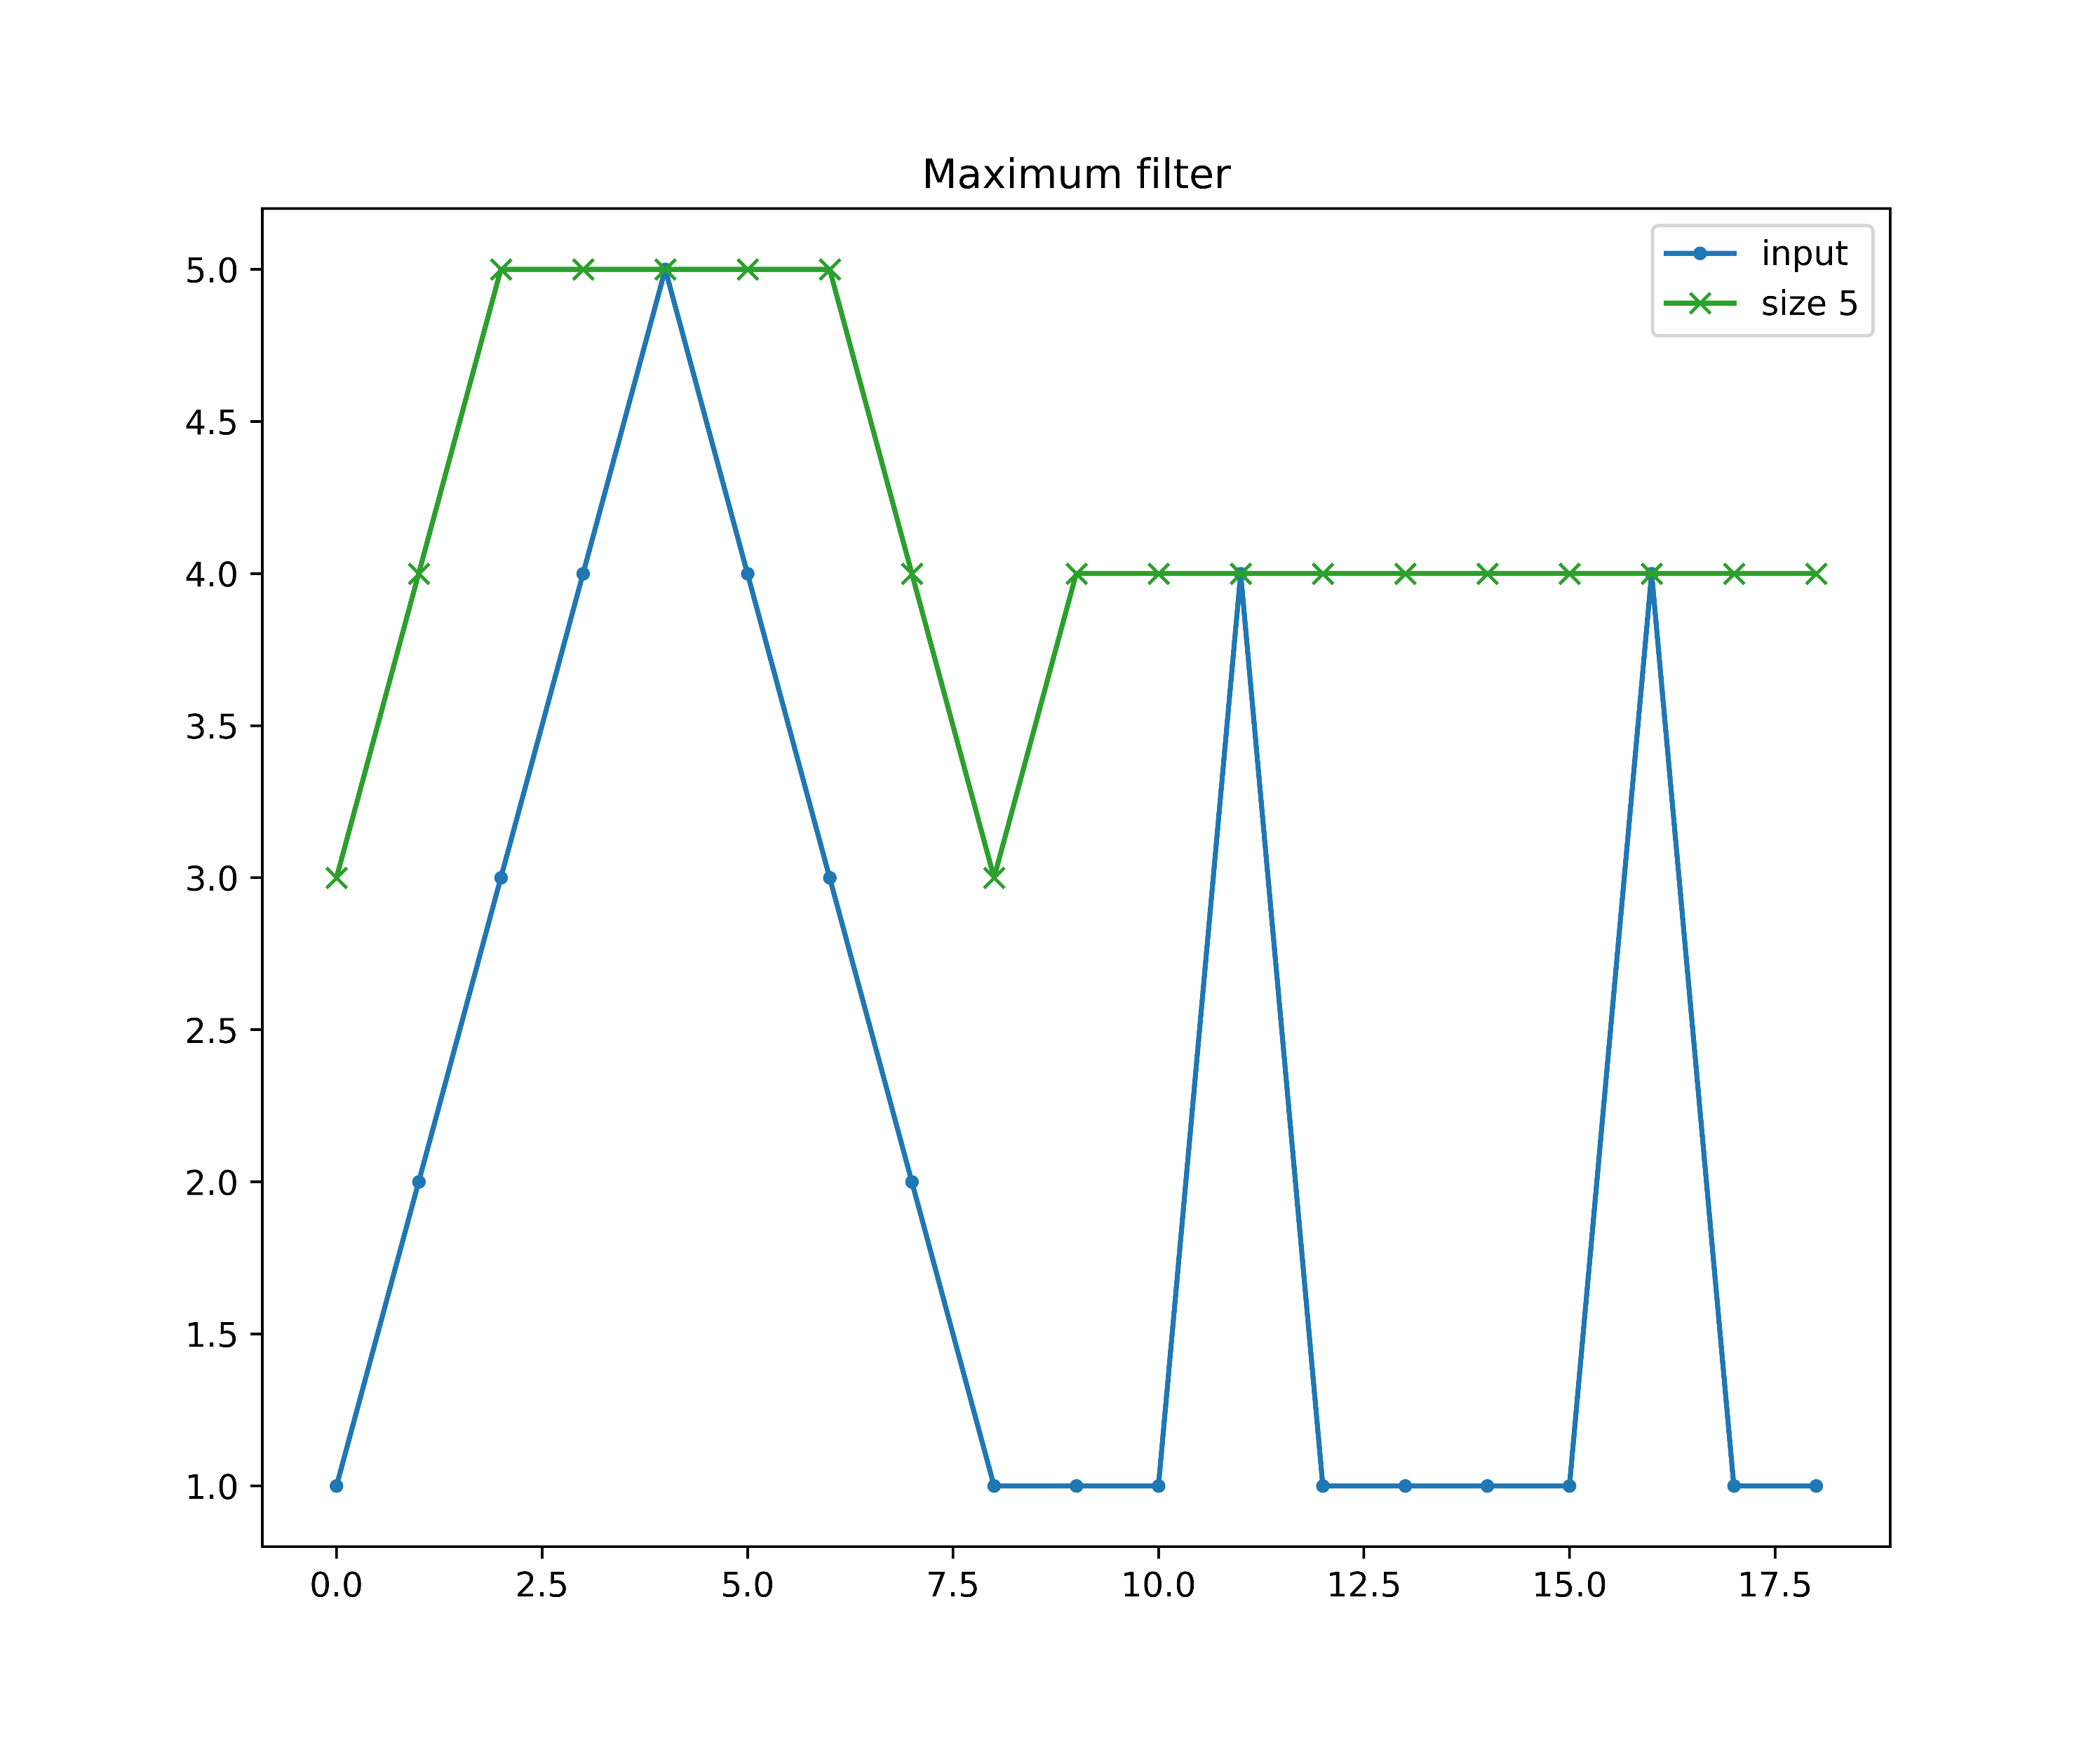
Non-max suppression
scipy.ndimage.maximum_filter

Slide 24
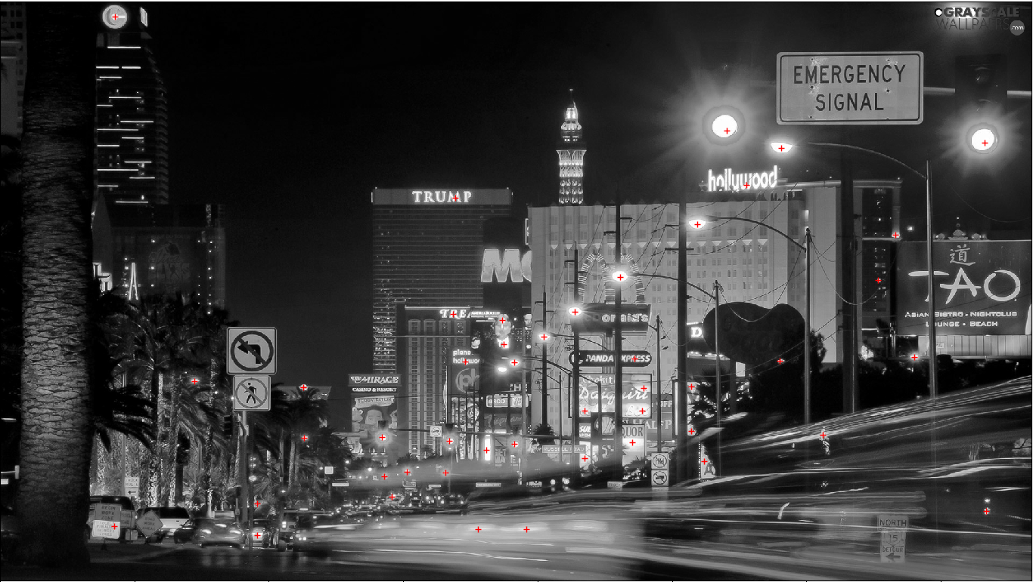
Non-max suppression
Result after NMS (+other tricks that you will invent yourselves)

Slide 25
Thank you all
Questions ??

Slide 26
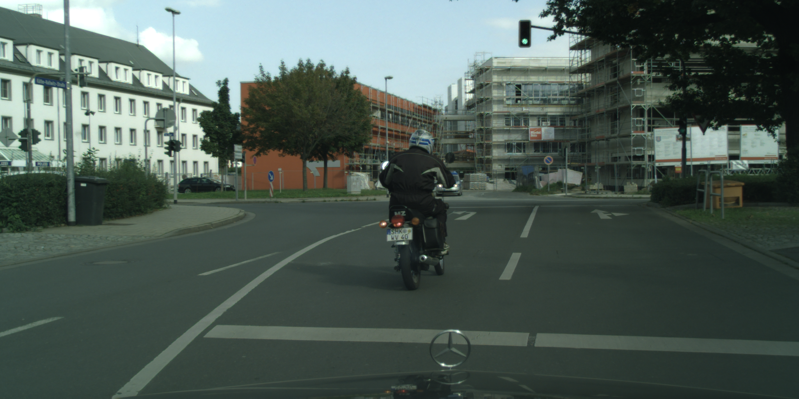
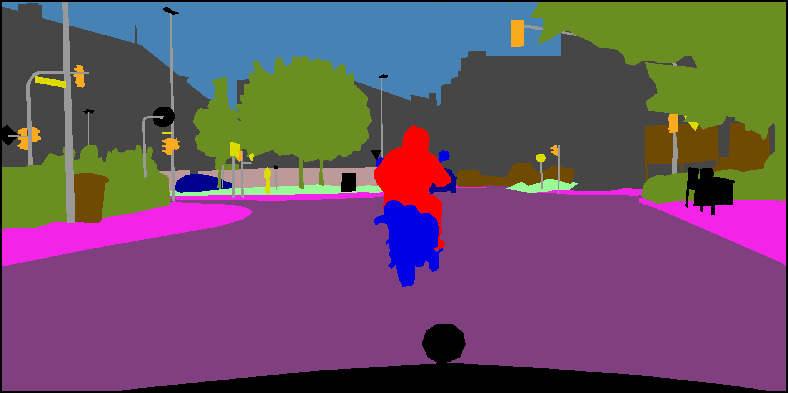
The exercise

Slide 27
The exercise
Just find the front-facing traffic lights (=TFL)… No more!
Measure coverage (% of TFLs detected) and total # points
GT provided for all TFLs ☹ Baasa…

Slide 28
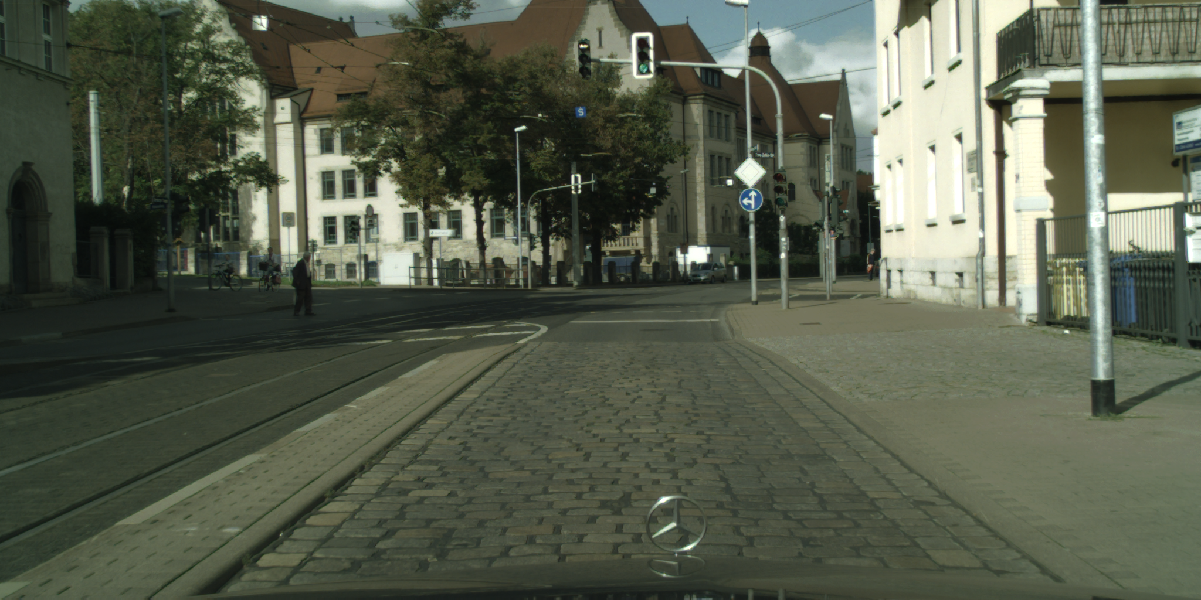
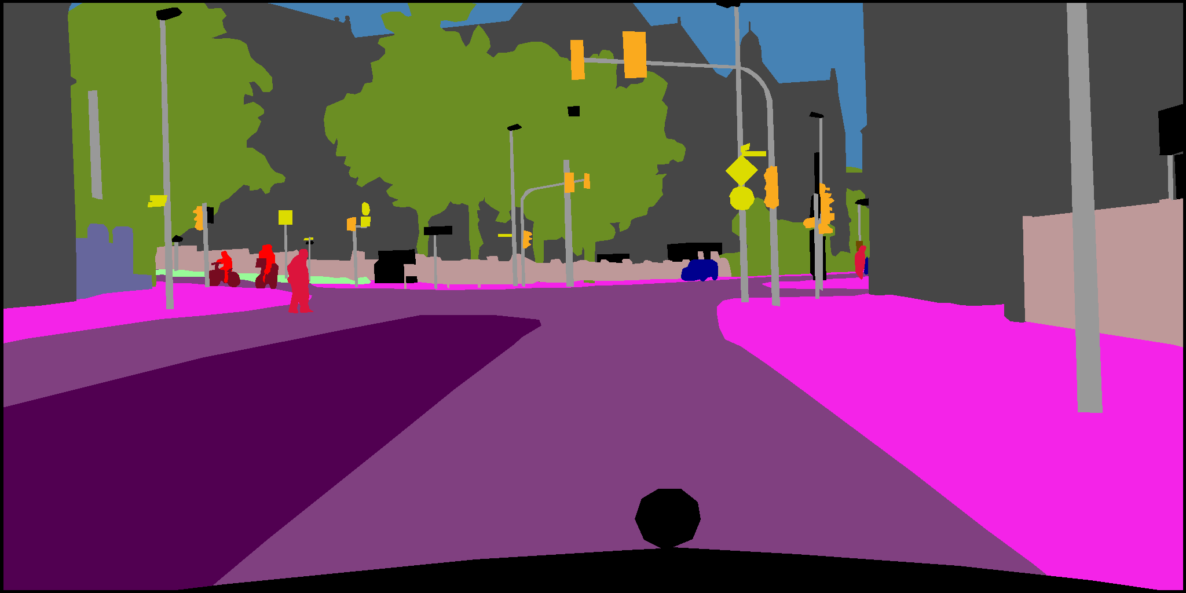
The exercise
TFLs have RED and GREEN lights. Find all
Implement this function:
x_red, y_red, x_green, y_green = find_tfl_lights(c_image,**kwargs)

Slide 29
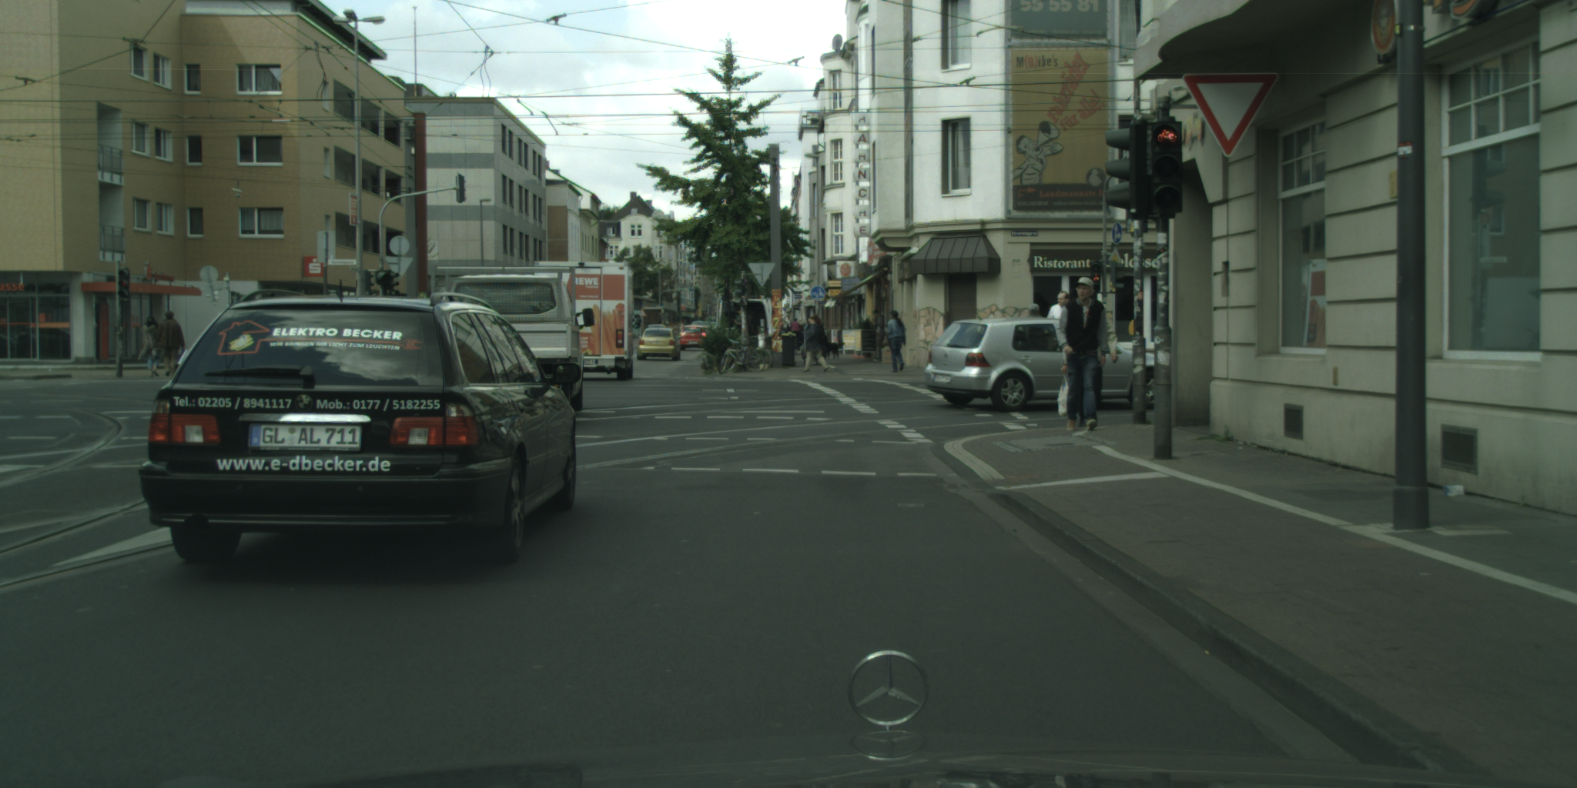
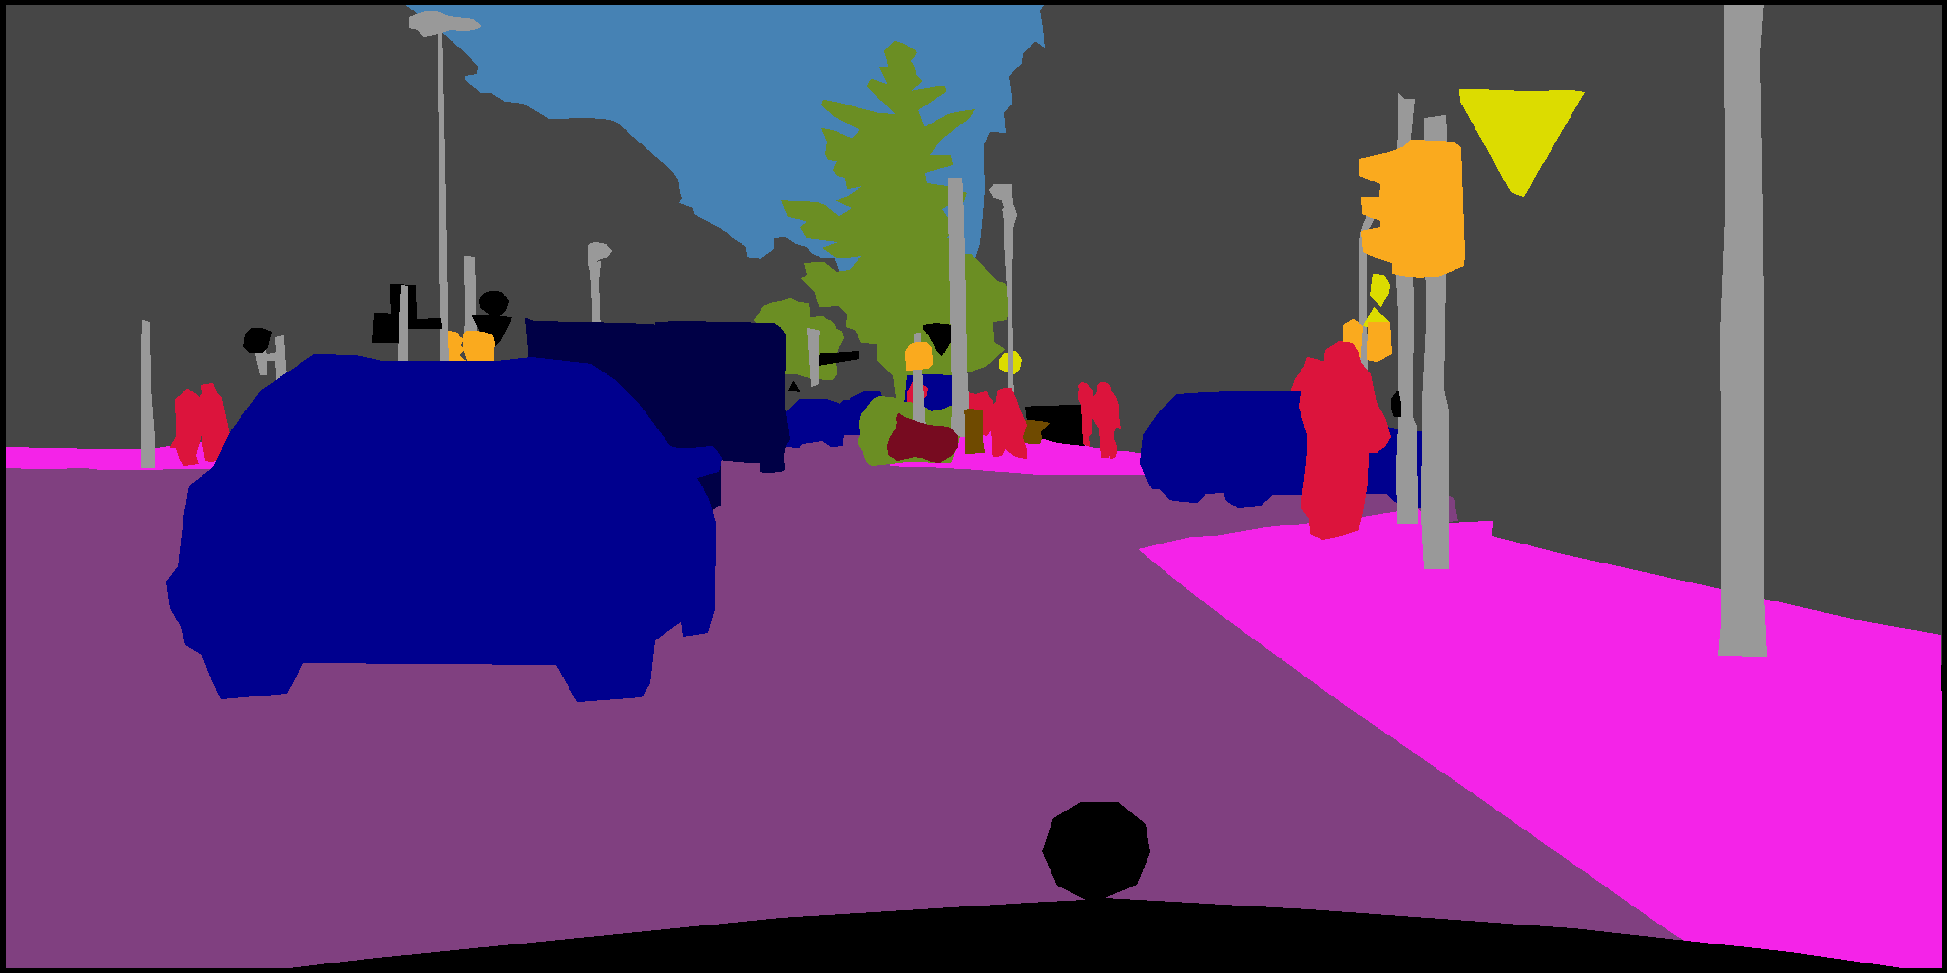
The exercise
Can read an image using:
from PIL import Image
image = np.array(Image.open(image_path))

Slide 30
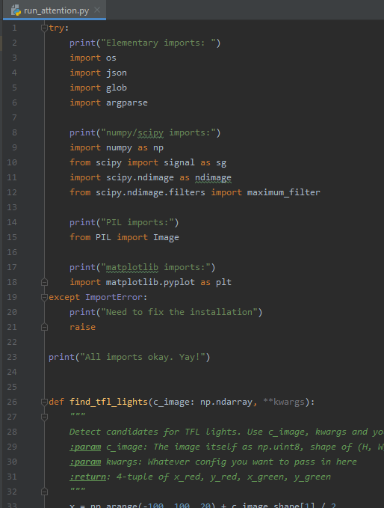
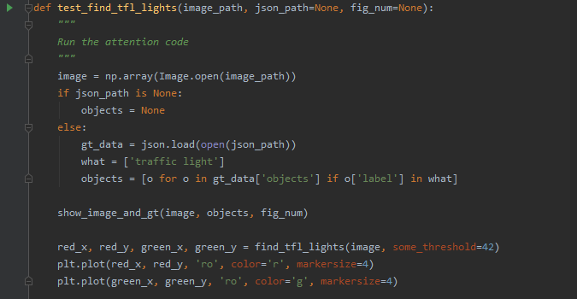
Test pilot
Use this code to test your environment
Gives you a kick-start to reading and displaying images
Now all you have to do is implement the algorithm

Slide 31
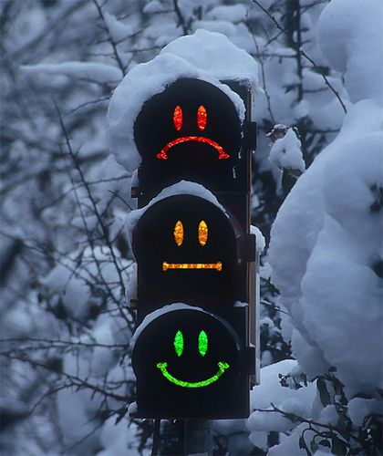
Good luck!

